Slide 1
(A) COLOR VISION
* Physical world and perception
* Physics: radiation
------------------------
* Radiant energy: Radiometry and Photometry
- Magnitudes and units
. Geometry of radiometric setting
. Radiant Flux (W/nm)
. Radiant intensity (W/nm*m2*str)
. Radiance (W/nm*m2*str –in the direction of emission!-) / Irradiance (W/nm*m2)
. First model of visual system: the spectral sensitivity function V_lambda (adimensional)
. Luminous flux (lm)
. Luminous intensity (lm/m2*str)
. Luminance (lm/m2*str = cd/m2) /illumination (lm/m2 = lux)
- Incoming and outcoming light -> Reflectance (adimensional)
. Lambertian sources and reflectors
. Some expressions
. Radiance of surface from radiance of illuminant
- Irradiance at sensor (with no optical system) from radiance of source (or surface)
. Irradiance at sensor (with optical system) from radiance of source (or surface)
* Perception: What is color?: (perceptual) dimensions of color
-----------------------------------------------------------------------
- Absolute dimensions
. Brightness Q
. Hue h
. Colorfulness M
- Relative dimensions
. Lightness J = Q/Q0
. Chroma (C = M/Q0 ) & Saturation ( S = M/Q )
- Interesting phenomena
. Color constancy / chromatic adaptation
. Induction (contrast and assimilation)
. Aftereffects
* Classical tristimulus colorimetry (the LINEAR model)
-------------------------------------------------------------------------
- Tristimulus values
. Color matching experiences (additive color reproduction) & Metamerism (1st definition)
. Primaries / White / Trichromatic units -> tristimulus values
. Grassmann laws (color -in simple settings!- is a 3D vector)
. Aditivity -> Tristimulus values from spectral radiance -> Color matching functions
. CIE XYZ 1931
. Metamerism revisited (by-product of strong dimensionality reduction).
. Change of space
. Change of color matching functions
- Other representations in tristimulus colorimetry
. Chromatic coordinates and Luminance
Properties of the chromatic diagram
. Dominant wavelength, Purity and Luminance
- Are all tristimulus basis the same?. Opponent spaces
. Observations of Hering and color vision of dichromats
. Color confusion lines, confusion centers and LMS primaries
. Hue cancelation experiments and opponent color matching functions
. Opponent spaces ATD, Y-RG-YB, (YUV, YIQ, YCrCb, ... zzz)
- Limitations of (linear!) tristimulus colorimetry
. Poor perceptual descriptors (not totally decorrelated dimensions)
. Non-Euclidean geometry (MacAdam ellipses)
. Linearity -> strong change with illuminant -> chromatic adaptation transforms are needed.
* Color appearance models (NONLINEAR models)
--------------------------------------------------------------------
- Von-Kries adaptation
- Weber/Krauskopf-Gegenfurtner nonlinearities
- Distance computation after nonlinear models
- CIE Lab 1976 and CIE CAM 2000
* Physiological mechanisms
---------------------------------------
- Cones (LMS) at the retina
- Center-surround opponent cells (ATD) at LGN
- Double opponent cells (chromatic Gabors ATD) at V1
* Color statistics (information-theoretic reasons for the behavior)
---------------------------------------------------------------------------------------------
- The manifold of colors in natural images
. Strong correlation
. Conic shape
. Changes with illumination
- Principal components of the color manifold and manifold alignement techniques
- Nonuniformities in the marginals -> optimal transmission of color information
* Yeah, yeah, but the brain doesnt work like that...
------------------------------------------------------------------
- Too strong separation between color and spatial perception -> go to point B
* Technical notes
-----------------------
- Color in computers. Calibration issues.
- Do it yourself (in Matlab): COLORLAB

Slide 2
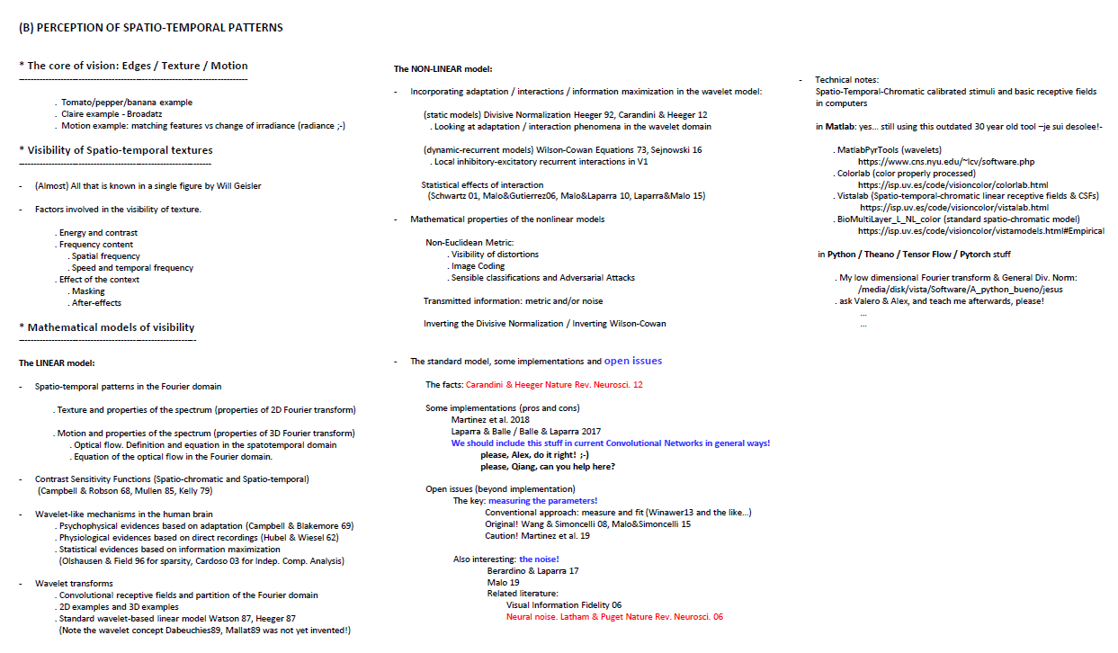

Slide 3
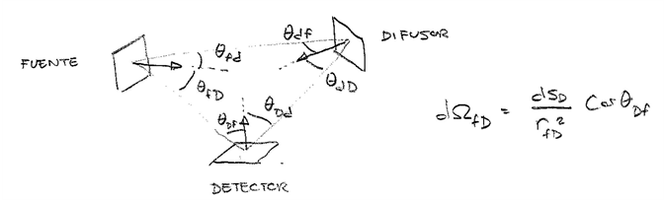
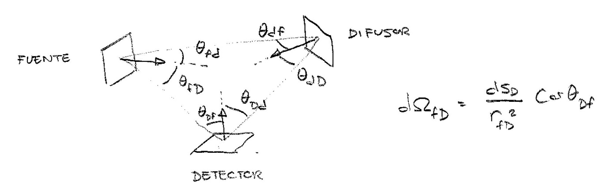
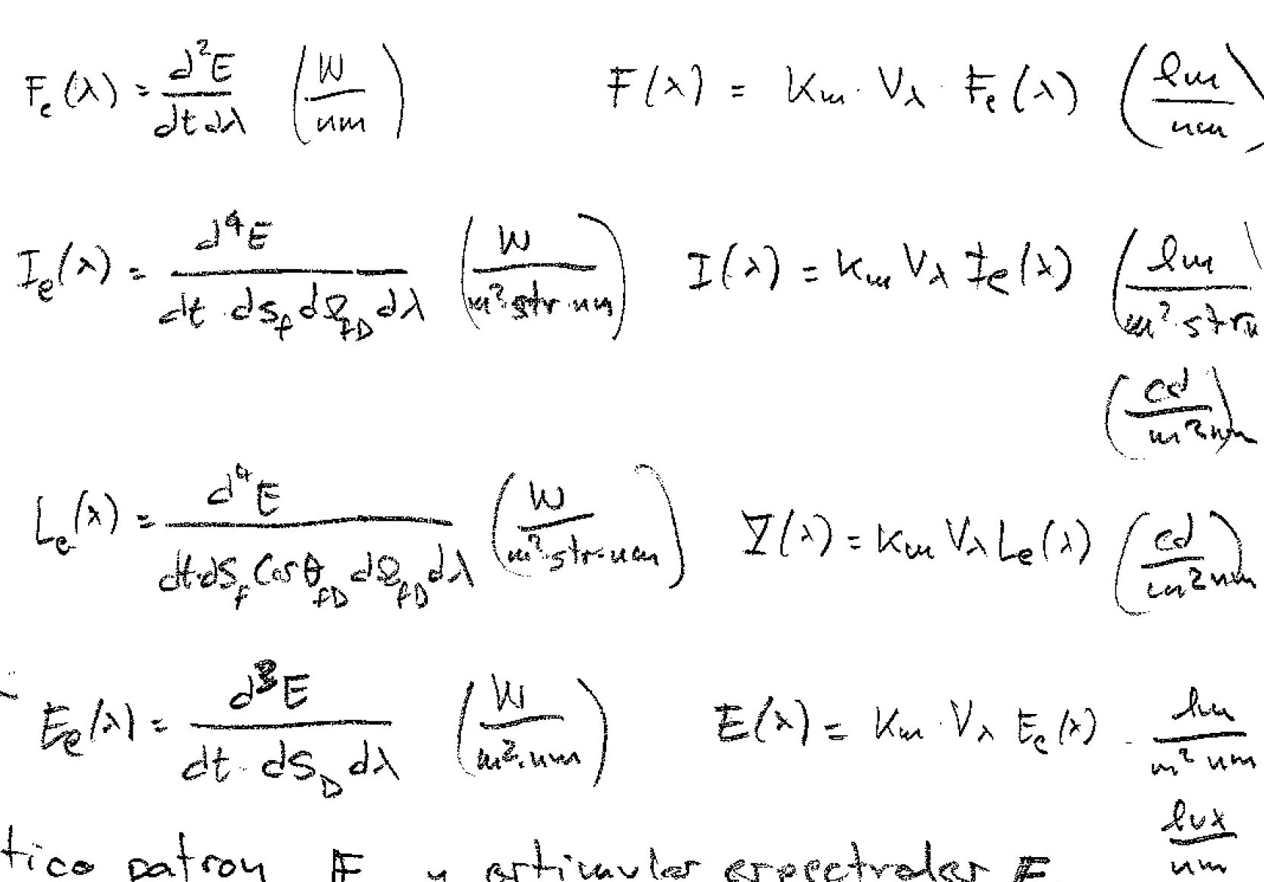
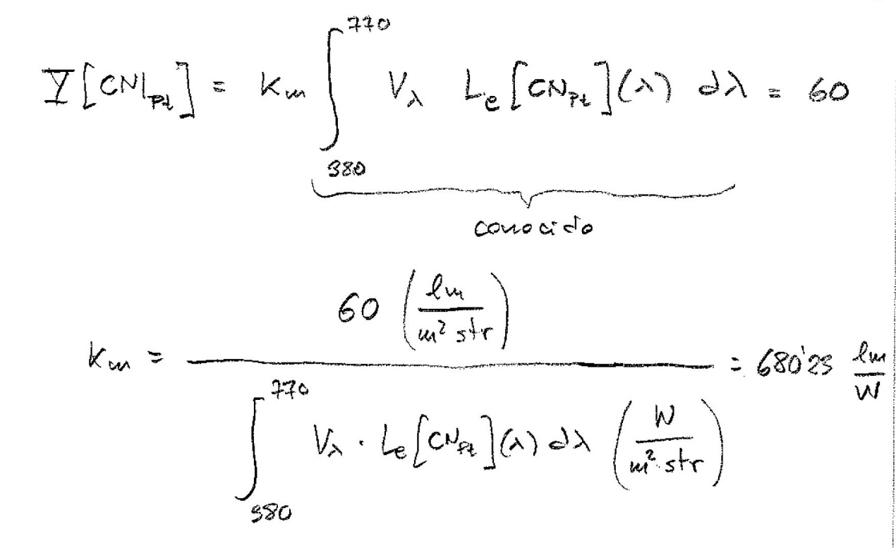





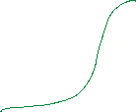


Slide 4
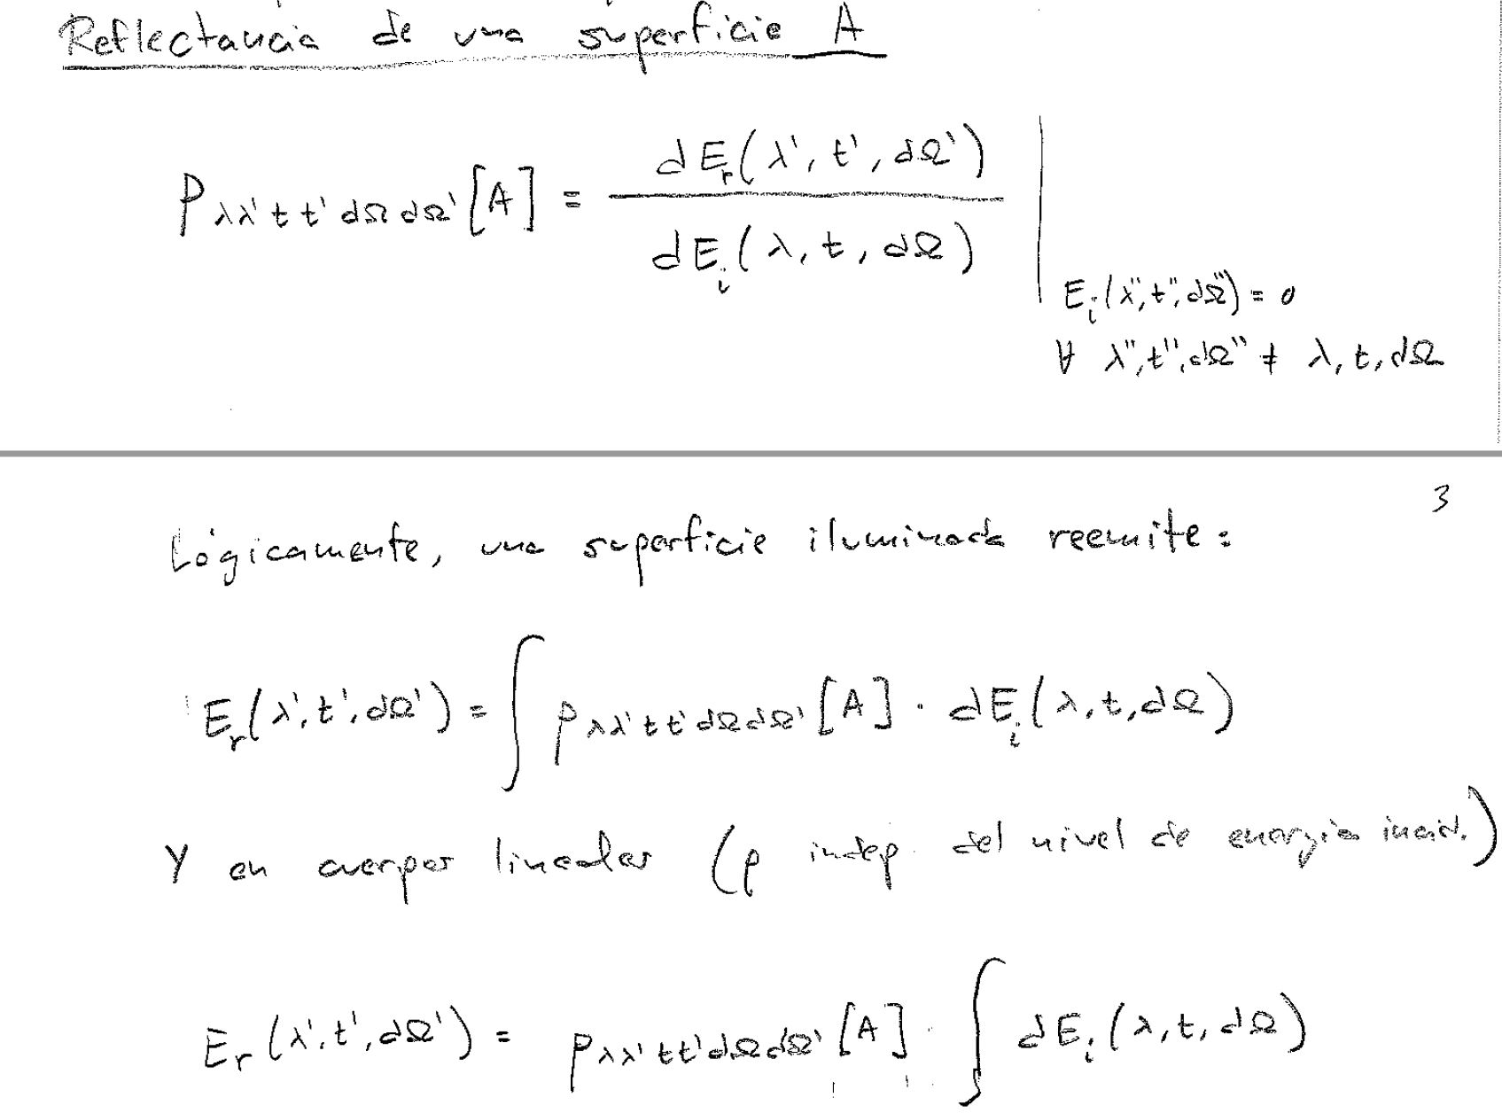


Slide 5
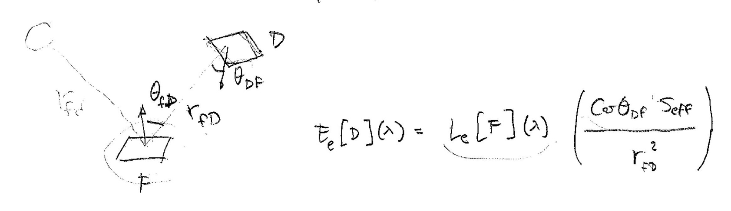
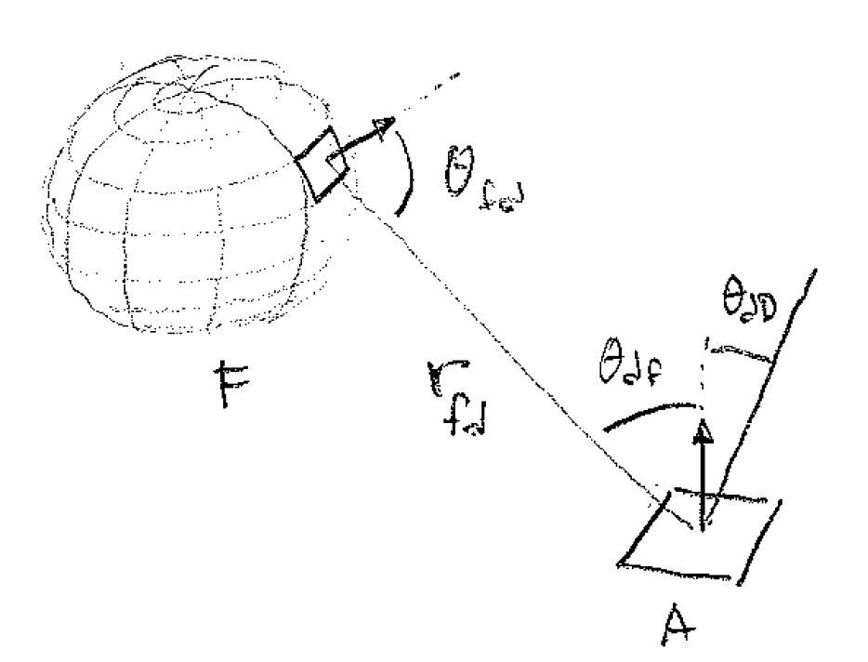
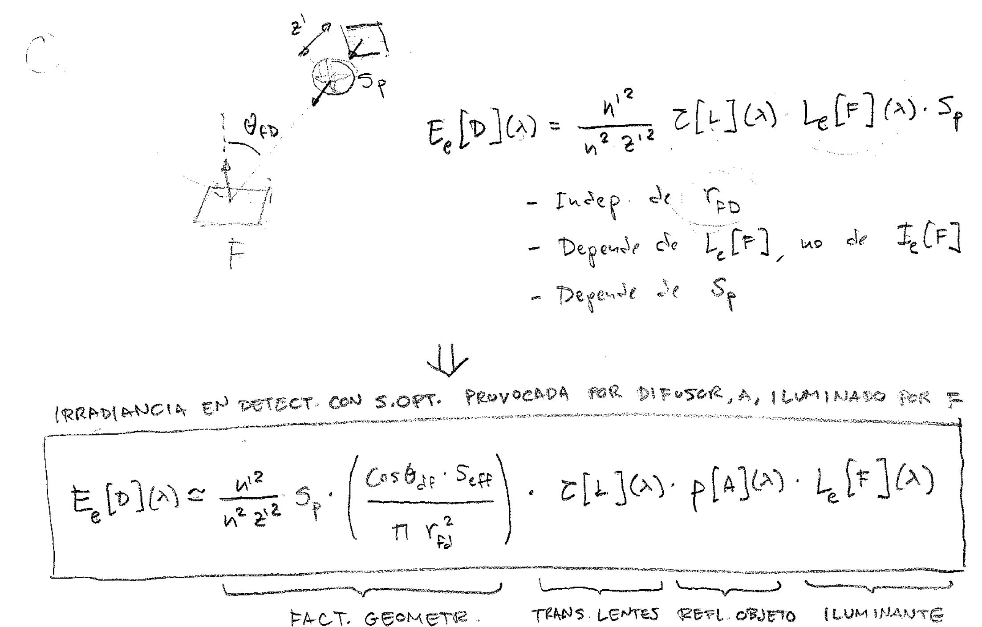
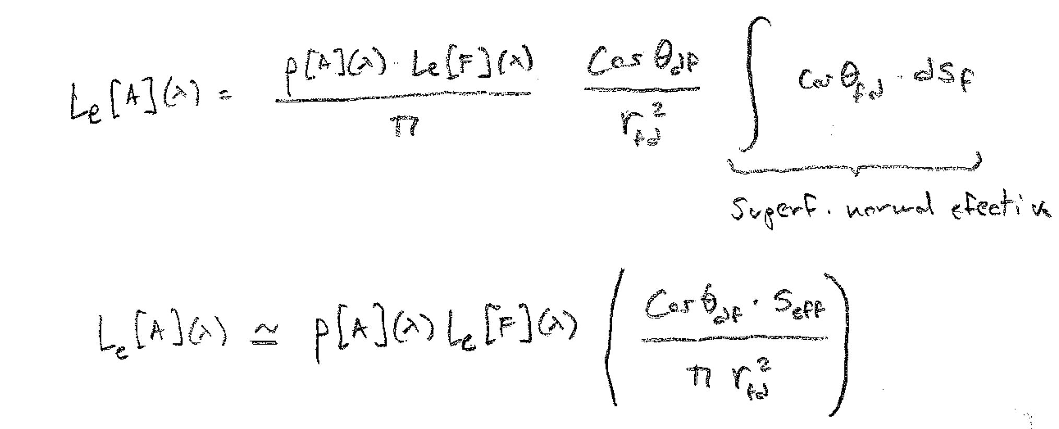
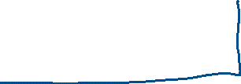







Slide 6
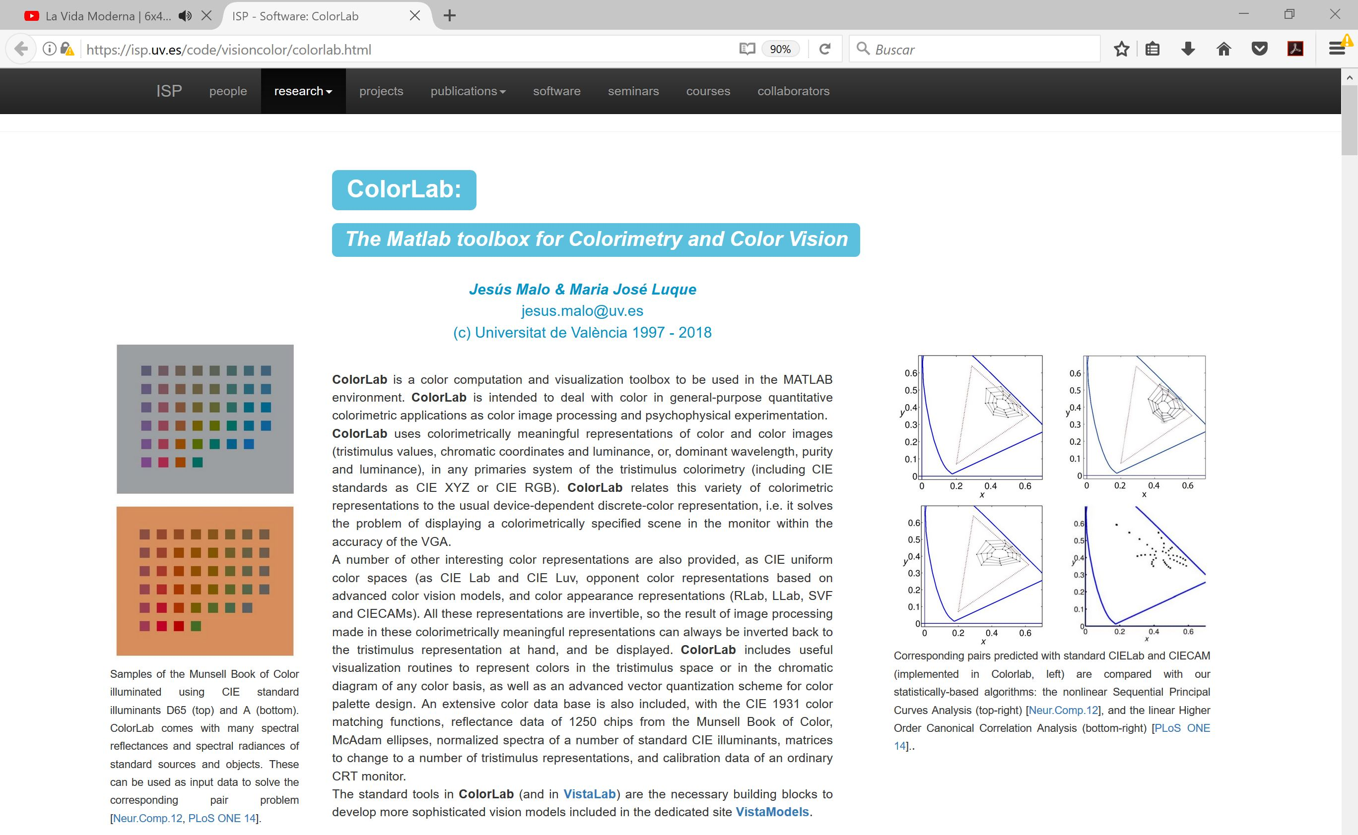
https://isp.uv.es/code/visioncolor/colorlab.html

Slide 7
- Limitations of (linear!) tristimulus colorimetry
. Poor perceptual descriptors (not totally decorrelated dimensions)
. Non-Euclidean geometry (MacAdam ellipses)
. Linearity -> strong change with illuminant -> chromatic adaptation transforms are needed.
* Color appearance models (NONLINEAR models)
--------------------------------------------------------------------
- Von-Kries adaptation and Divisive Normalization

Slide 8
(B) PERCEPTION OF SPATIO-TEMPORAL PATTERNS
* The core of vision: Edges / Texture / Motion
----------------------------------------------------------------------------
. Tomato/pepper/banana example
. Claire example - Broadatz
. Motion example: matching features vs change of irradiance (radiance ;-)
* Visibility of Spatio-temporal textures
----------------------------------------------------------------
(Almost) All that is known in a single figure by Will Geisler
Factors involved in the visibility of texture.
. Energy and contrast
. Frequency content
. Spatial frequency
. Speed and temporal frequency
. Effect of the context
. Masking
. After-effects
* Mathematical models of visibility
-----------------------------------------------------------
The LINEAR model:
Spatio-temporal patterns in the Fourier domain
. Texture and properties of the spectrum (properties of 2D Fourier transform)
. Motion and properties of the spectrum (properties of 3D Fourier transform)
. Optical flow. Definition and equation in the spatotemporal domain
. Equation of the optical flow in the Fourier domain.
Contrast Sensitivity Functions (Spatio-chromatic and Spatio-temporal)
(Campbell & Robson 68, Mullen 85, Kelly 79)
Wavelet-like mechanisms in the human brain
. Psychophysical evidences based on adaptation (Campbell & Blakemore 69)
. Physiological evidences based on direct recordings (Hubel & Wiesel 62)
. Statistical evidences based on information maximization
(Olshausen & Field 96 for sparsity, Cardoso 03 for Indep. Comp. Analysis)
Wavelet transforms
. Convolutional receptive fields and partition of the Fourier domain
. 2D examples and 3D examples
. Standard wavelet-based linear model Watson 87, Heeger 87
(Note the wavelet concept Dabeuchies89, Mallat89 was not yet invented!)
The NON-LINEAR model:
Incorporating adaptation / interactions / information maximization in the wavelet model:
(static models) Divisive Normalization Heeger 92, Carandini & Heeger 12
. Looking at adaptation / interaction phenomena in the wavelet domain
(dynamic-recurrent models) Wilson-Cowan Equations 73, Sejnowski 16
. Local inhibitory-excitatory recurrent interactions in V1
Statistical effects of interaction
(Schwartz 01, Malo&Gutierrez06, Malo&Laparra 10, Laparra&Malo 15)
Mathematical properties of the nonlinear models
Non-Euclidean Metric:
. Visibility of distortions
. Image Coding
. Sensible classifications and Adversarial Attacks
Transmitted information: metric and/or noise
Inverting the Divisive Normalization / Inverting Wilson-Cowan
The standard model, some implementations and open issues
The facts: Carandini & Heeger Nature Rev. Neurosci. 12
Some implementations (pros and cons)
Martinez et al. 2018
Laparra & Balle / Balle & Laparra 2017
We should include this stuff in current Convolutional Networks in general ways!
please, Alex, do it right! ;-)
please, Qiang, can you help here?
Open issues (beyond implementation)
The key: measuring the parameters!
Conventional approach: measure and fit (Winawer13 and the like…)
Original! Wang & Simoncelli 08, Malo&Simoncelli 15
Caution! Martinez et al. 19
Also interesting: the noise!
Berardino & Laparra 17
Malo 19
Related literature:
Visual Information Fidelity 06
Neural noise. Latham & Puget Nature Rev. Neurosci. 06
Technical notes:
Spatio-Temporal-Chromatic calibrated stimuli and basic receptive fields
in computers
in Matlab: yes… still using this outdated 30 year old tool –je sui desolee!-
. MatlabPyrTools (wavelets)
https://www.cns.nyu.edu/~lcv/software.php
. Colorlab (color properly processed)
https://isp.uv.es/code/visioncolor/colorlab.html
. Vistalab (Spatio-temporal-chromatic linear receptive fields & CSFs)
https://isp.uv.es/code/visioncolor/vistalab.html
. BioMultiLayer_L_NL_color (standard spatio-chromatic model)
https://isp.uv.es/code/visioncolor/vistamodels.html#Empirical
in Python / Theano / Tensor Flow / Pytorch stuff
. My low dimensional Fourier transform & General Div. Norm:
/media/disk/vista/Software/A_python_bueno/jesus
. ask Valero & Alex, and teach me afterwards, please!
…
…

Slide 9
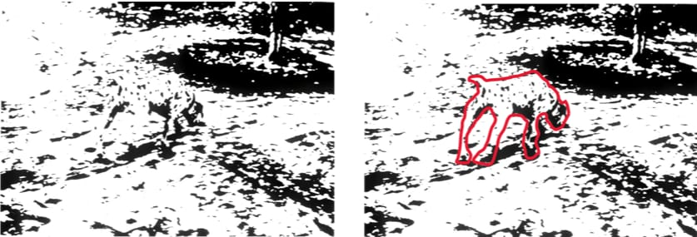

Slide 11


Slide 12
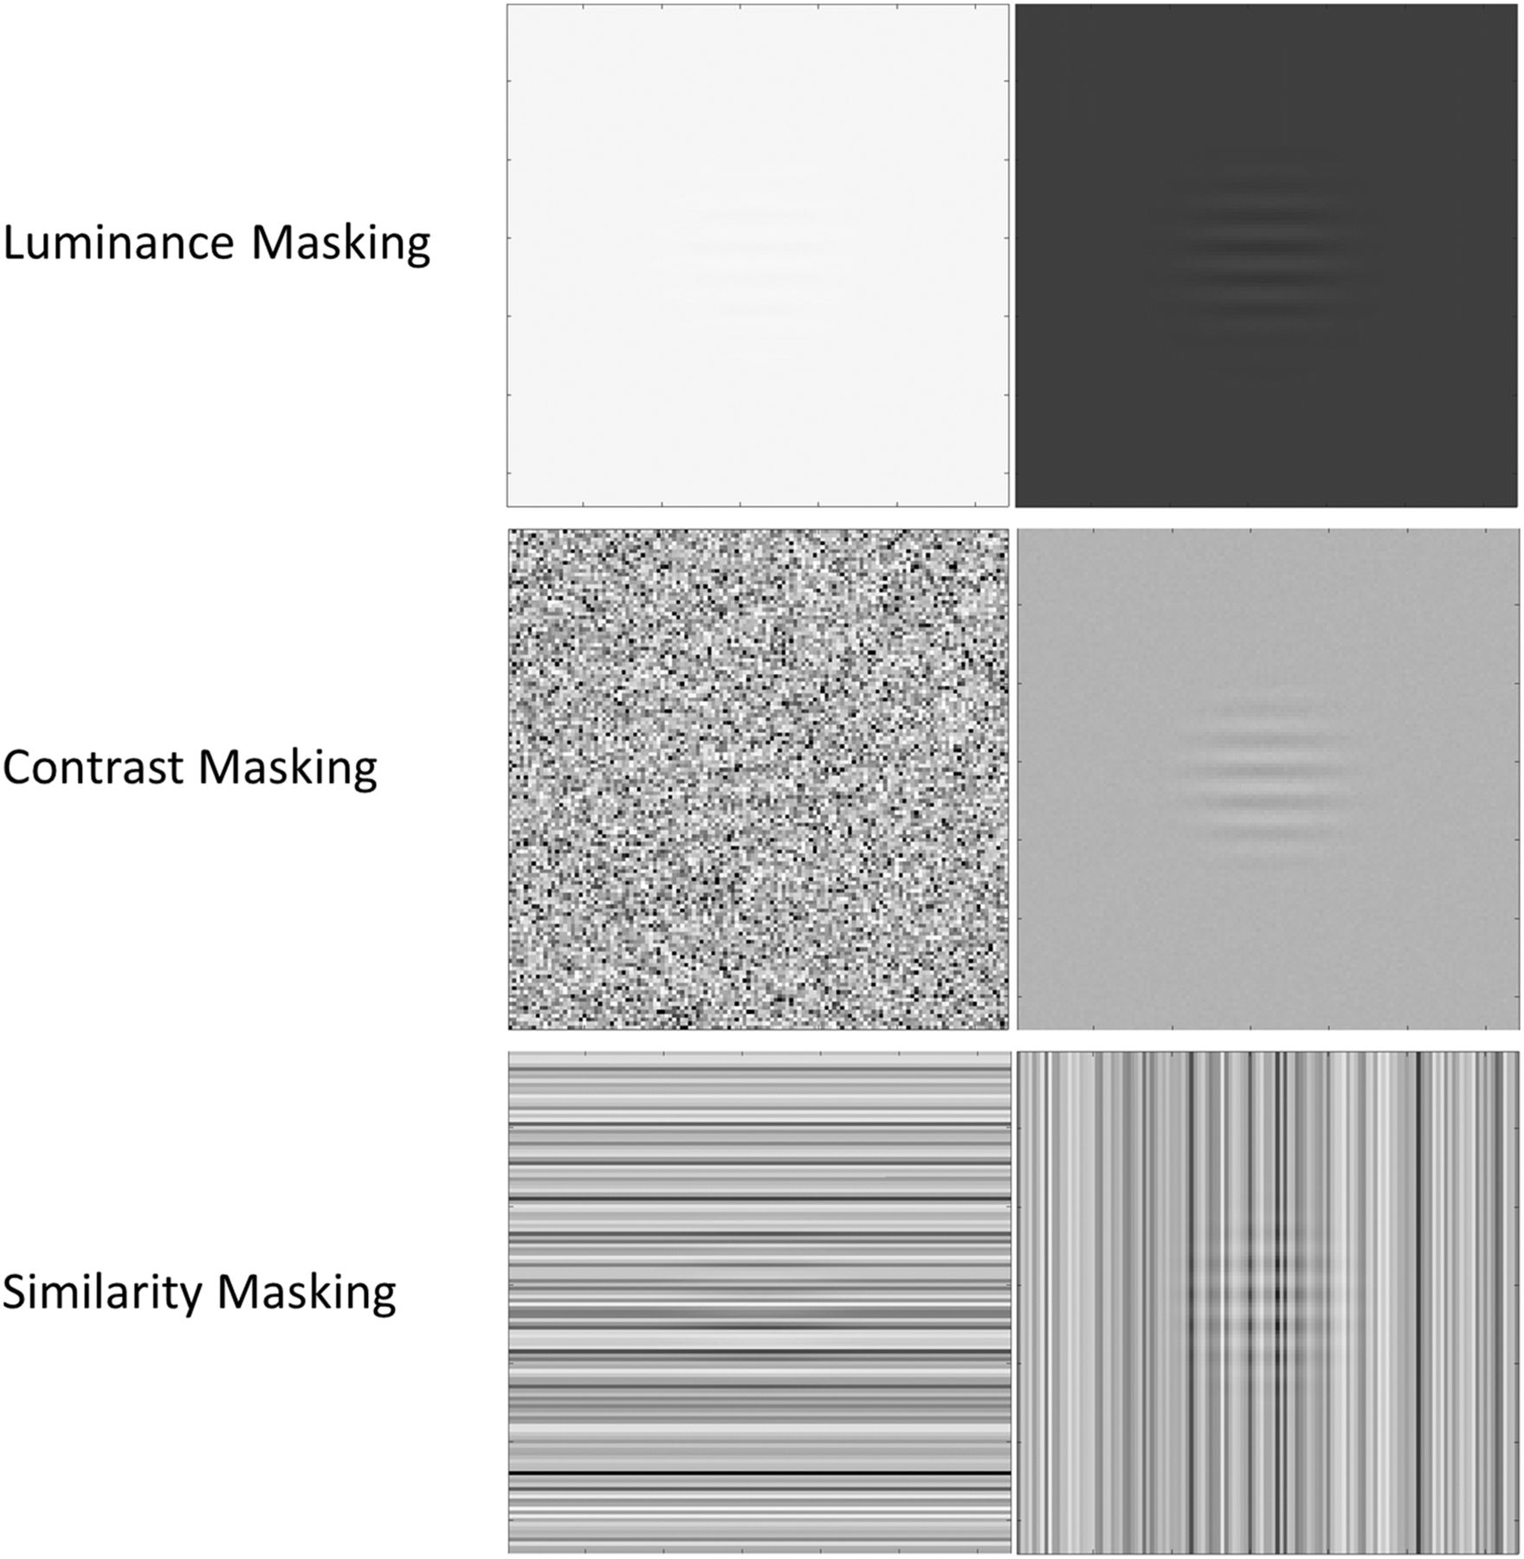

Slide 14


Slide 15




